Slide 1
Week 8
COMP10001

Slide 2
What is a “library”? How do we access them?

Slide 3
What is a “library”? How do we access them?
A library contains a group of methods and/or variables that can extend Python to perform a more diverse set of tasks, without the need to write our own functions

Slide 4
What is a “library”? How do we access them?
A library contains a group of methods and/or variables that can extend Python to perform a more diverse set of tasks, without the need to write our own functions
We import libraries:
import numpy

Slide 5
What is a “library”? How do we access them?
A library contains a group of methods and/or variables that can extend Python to perform a more diverse set of tasks, without the need to write our own functions
We import libraries:
import numpy
And we can assign temporary names:
import numpy as np

Slide 6
What is a “defaultdict”? How do we initialise and use one?

Slide 7
What is a “defaultdict”? How do we initialise and use one?
Just like a dictionary, but new keys are initialised to a default value so that we don’t have to initialise them explicitly!

Slide 8
What is a “defaultdict”? How do we initialise and use one?
Just like a dictionary, but new keys are initialised to a default value so that we don’t have to initialise them explicitly!
We need to import defaultdicts from the collections library:
from collections import defaultdict

Slide 9
What is a “defaultdict”? How do we initialise and use one?
Just like a dictionary, but new keys are initialised to a default value so that we don’t have to initialise them explicitly!
We need to import defaultdicts from the collections library:
from collections import defaultdict
And we should consider what type the default value in the defaultdict should be!
tally = defaultdict(int)

Slide 10
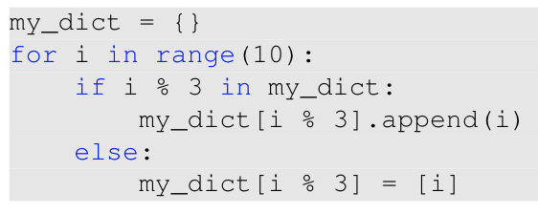
Rewrite the following with a defaultdict

Slide 11
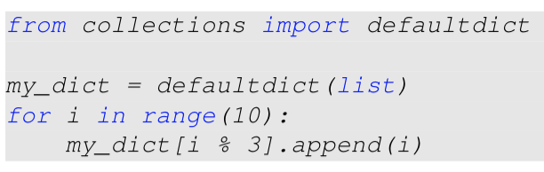
Rewrite the following with a defaultdict

Slide 12
What is a “bug”? What are some debugging strategies which we can use when we find an error?

Slide 13
What is a “bug”? What are some debugging strategies which we can use when we find an error?
Bug == problem!
Our code isn’t working how we think it should!

Slide 14
What is a “bug”? What are some debugging strategies which we can use when we find an error?
Bug == problem!
Our code isn’t working how we think it should!
Debugging strategies

Slide 15
What is a “bug”? What are some debugging strategies which we can use when we find an error?
Bug == problem!
Our code isn’t working how we think it should!
Debugging strategies
Compare test cases to expected outputs
Find the section that’s relevant to the error (e.g. write test cases for your helper functions)
Use diagnostic print statements to check what’s happening during code execution

Slide 16
What are the three types of errors we’ve learned about?

Slide 17
What are the three types of errors we’ve learned about?
Syntax
Run-time
Logic

Slide 18
What are the three types of errors we’ve learned about?
Syntax
Code won’t run as there’s something wrong with the syntax
Run-time
Logic

Slide 19
What are the three types of errors we’ve learned about?
Syntax
Code won’t run as there’s something wrong with the syntax
Run-time
The syntax is fine! Code won’t run as there’s an error that stops it during execution
Logic

Slide 20
What are the three types of errors we’ve learned about?
Syntax
Code won’t run as there’s something wrong with the syntax
Run-time
The syntax is fine! Code won’t run as there’s an error that stops it during execution
Logic
Code runs without appearing to create an error! But the output doesn’t match what we expect!

Slide 21
How can we use testing to find bugs or confirm our code runs properly? What are some strategies to write comprehensive test cases?

Slide 22
How can we use testing to find bugs or confirm our code runs properly? What are some strategies to write comprehensive test cases?
To be confident our code is correct, we need to test it on a broad range of possible inputs
Our code needs to work on all possible test cases, not just a specific set!

Slide 23
How can we use testing to find bugs or confirm our code runs properly? What are some strategies to write comprehensive test cases?
To be confident our code is correct, we need to test it on a broad range of possible inputs
Our code needs to work on all possible test cases, not just a specific set!
Think about the different parts of your code and ensure you have a test case to test each of your code’s components
We can’t usually test all possible inputs - instead we test each category of input

Slide 24
How can we use testing to find bugs or confirm our code runs properly? What are some strategies to write comprehensive test cases?
To be confident our code is correct, we need to test it on a broad range of possible inputs
Our code needs to work on all possible test cases, not just a specific set!
Think about the different parts of your code and ensure you have a test case to test each of your code’s components
We can’t usually test all possible inputs - instead we test each category of input
Don’t forget to test corner cases!

Slide 25
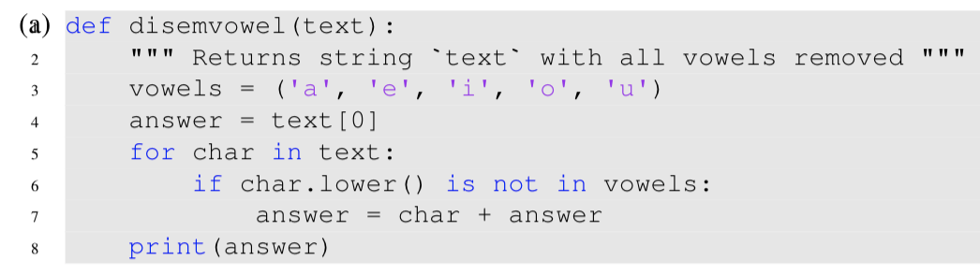
Find the errors! Classify them as syntax, run-time or logic and fix them with a correct line of code

Slide 26
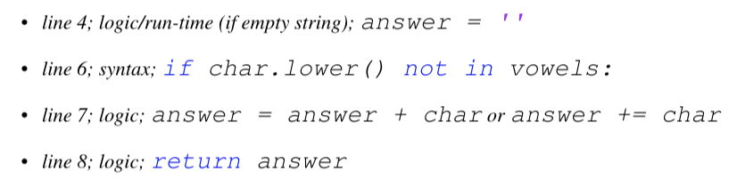
Find the errors! Classify them as syntax, run-time or logic and fix them with a correct line of code

Slide 27
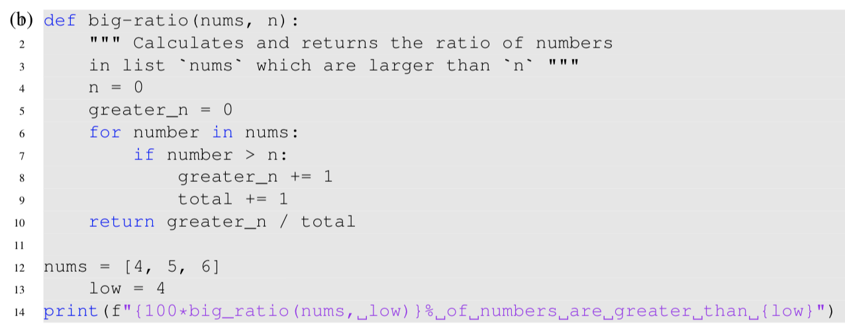
Find the errors! Classify them as syntax, run-time or logic and fix them with a correct line of code

Slide 28
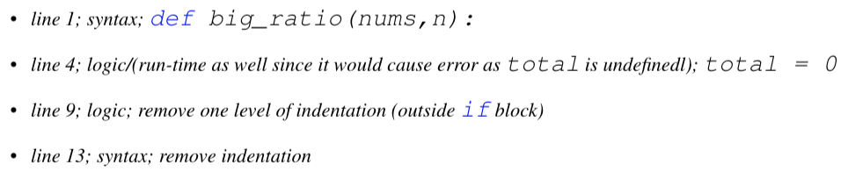
Find the errors! Classify them as syntax, run-time or logic and fix them with a correct line of code

Slide 29
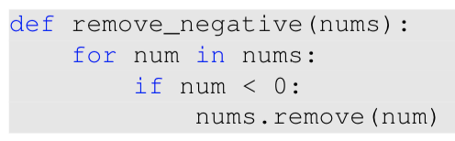
This function should take a list of integers and remove the negative integers from the list, but it doesn’t work :(
Write down three test cases that will help us find the bug
Debug the code snippet to solve the problem

Slide 30
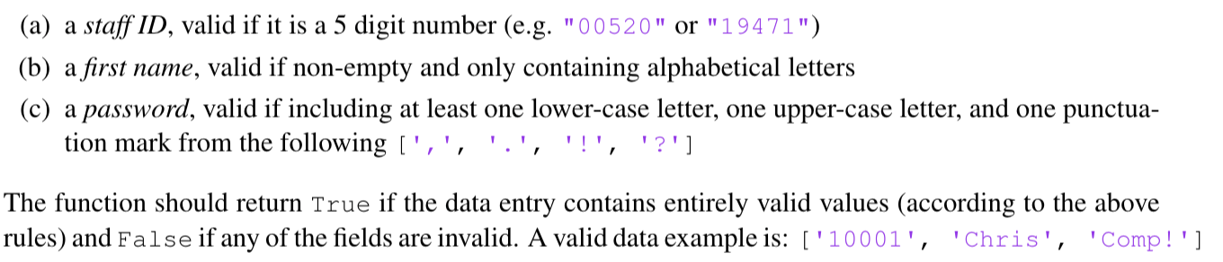
Previous exam question: this code validates a data entry, a list with the following string elements

Slide 31
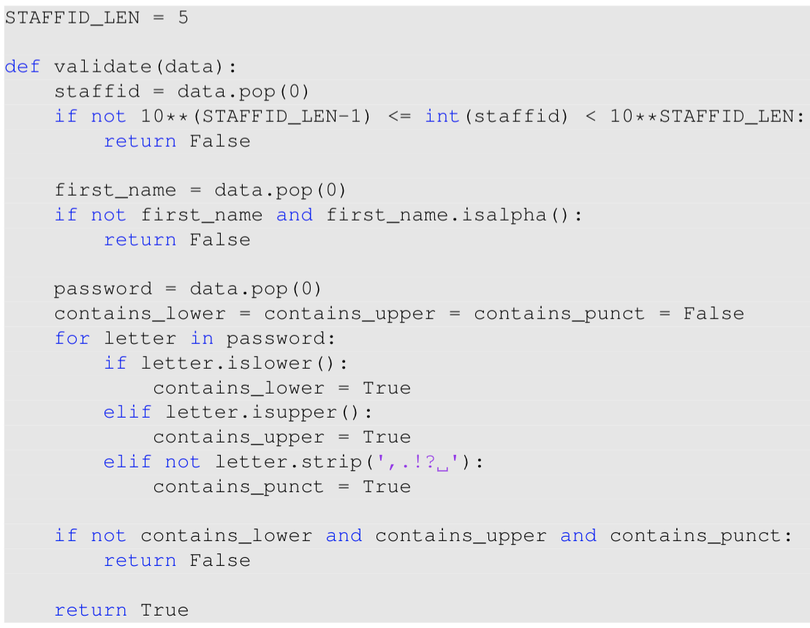
Previous exam question: this code validates a data entry, a list with the following string elements

Slide 32
Previous exam question: this code validates a data entry, a list with the following string elements
Provide an example of valid data that is correctly classified as such by the provided code (i.e. valid data input where the return value is True).
Provide an example of invalid data that is correctly classified as such by the provided code (i.e. invalid data input where the return value is False).
Provide an example of invalid data that is incorrectly classified as a valid by the provided code (i.e. valid data input where the return value is erroneously True).
Provide an example of valid data that is incorrectly classified as an invalid by the provided code (i.e. invalid data input where the return value is erroneously False).

